Slide 1

RESTAURANT MANAGEMENT SYSTEM
Team : Data Crunchers
ATULYA SHARMA
001306609
SHAILLY JAIN
001349428
SHASHANK SHETTY
001087432
VIVEK KOLI
001363809
SHASHI KIRAN MURUGESAN
001857286

Slide 2
PROBLEM STATEMENT
Restaurant is a kind of business that serves people all over world with ready-made food. Currently this industry is going on with lot of flare. People feel more comfortable with lot of variations in the selection and consumption of their food in their busy life
Restaurants face a lot of inefficiency problems like, order miscommunication, unavailability of raw ingredients, and excessive customer wait time in terms of both reserving a table to getting food late. All of this is a result of human error and paper based data management system

Slide 3
SOLUTION TO THE PROBLEM
Using inventory management system to keep a record of ingredients and keeping a check on their freshness
Using employee database to keep records of employee
Introducing a system to keep dine-in order management
Keeping data of employee shifts

Slide 4
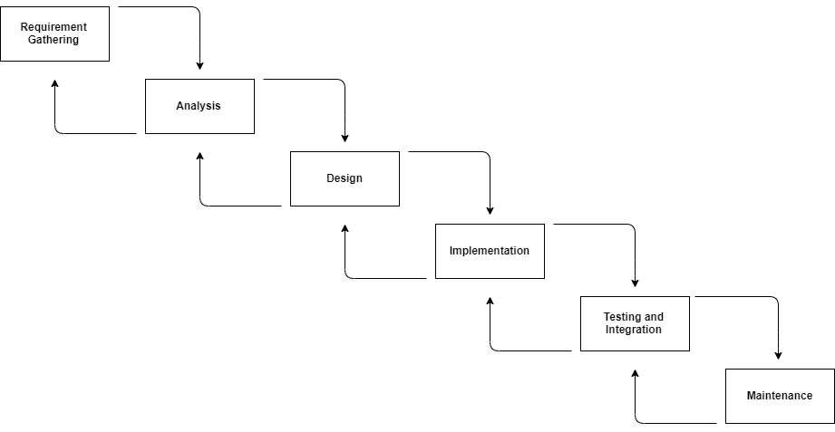
HIGH LEVEL DESIGN

Slide 5
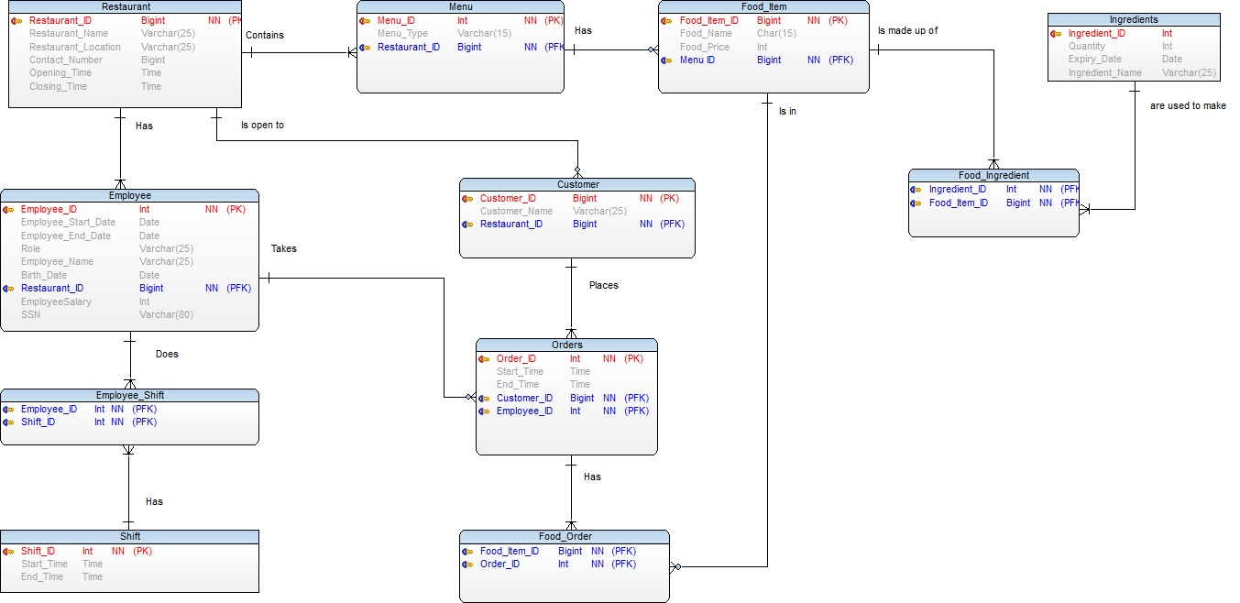
ERD Diagram

Slide 6
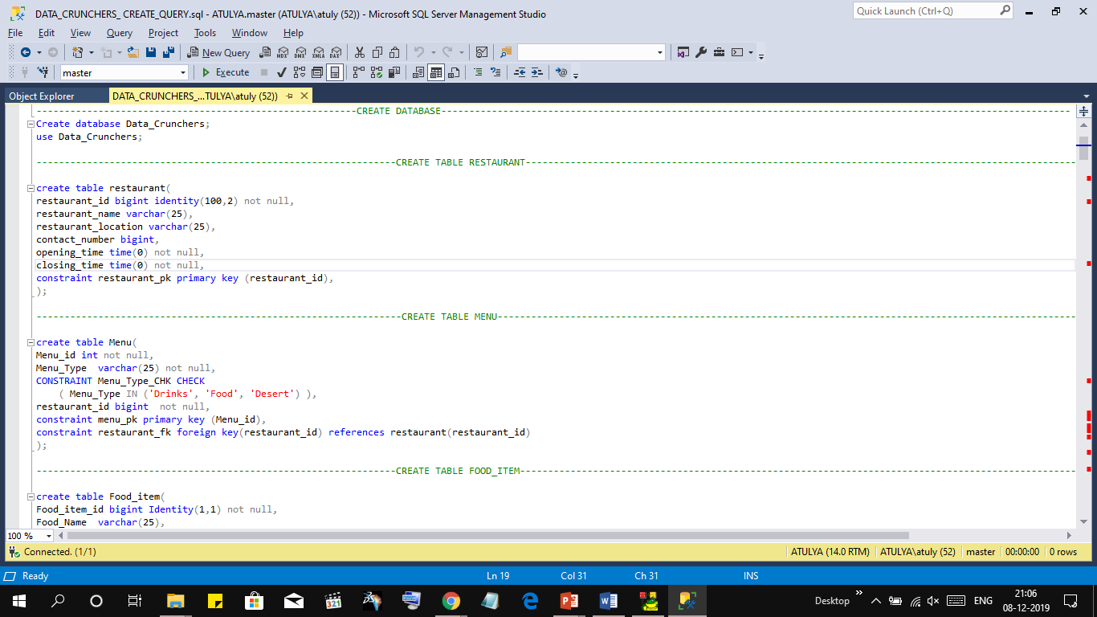
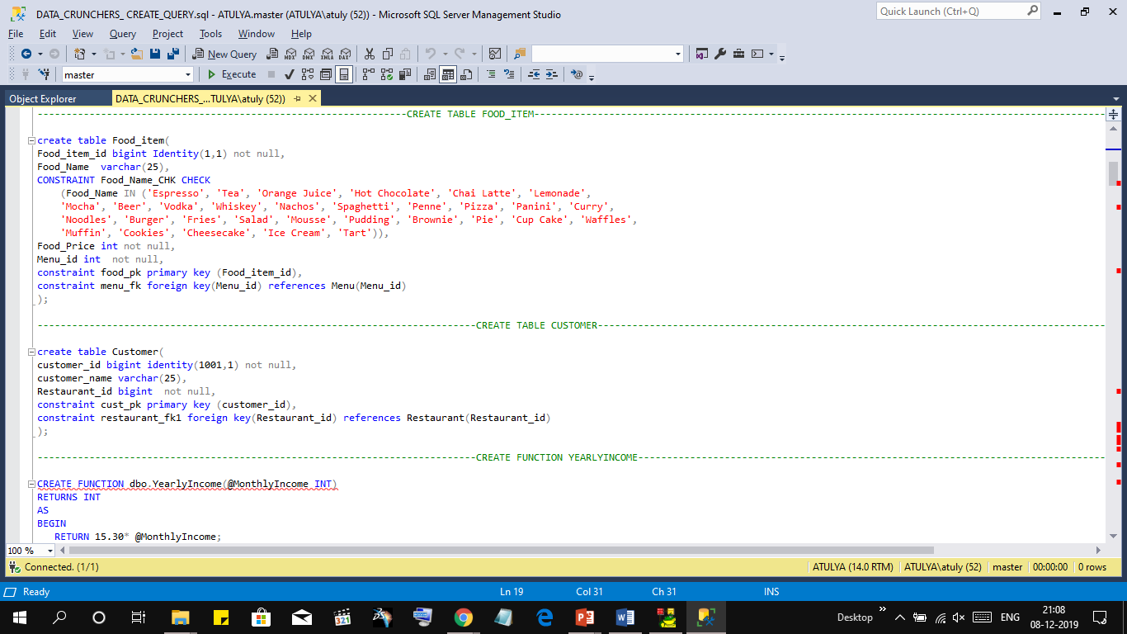
DDL STATEMENTS

Slide 7
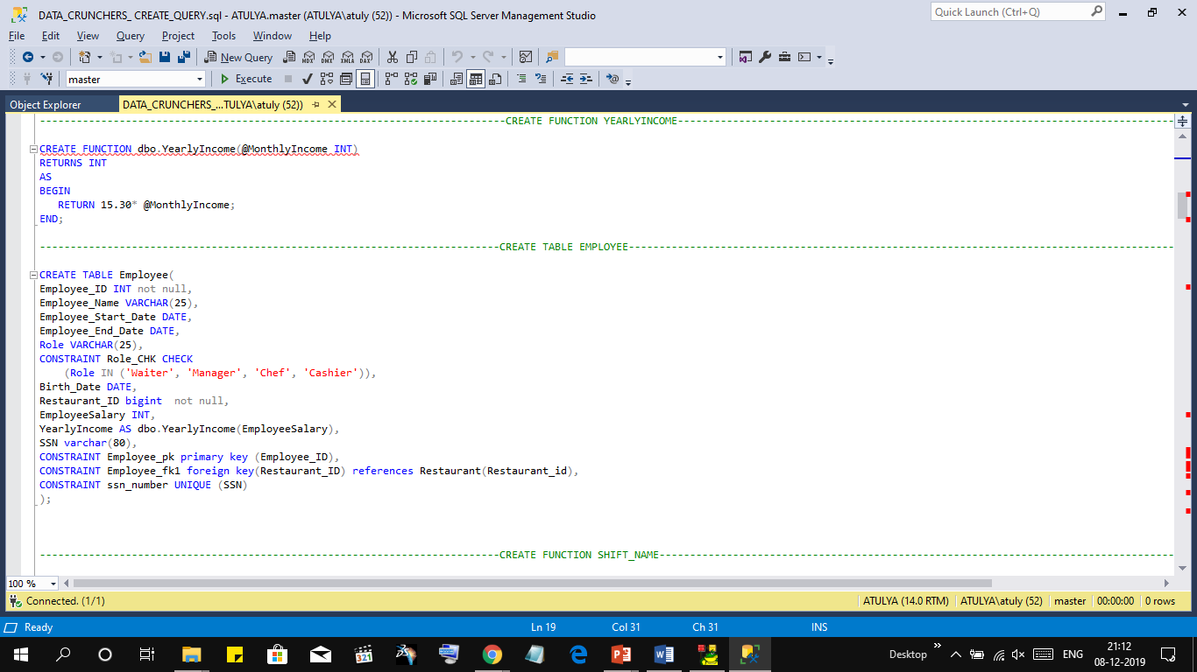
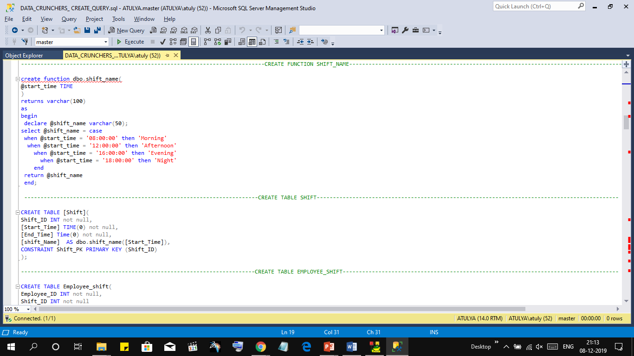
DDL STATEMENTS

Slide 8
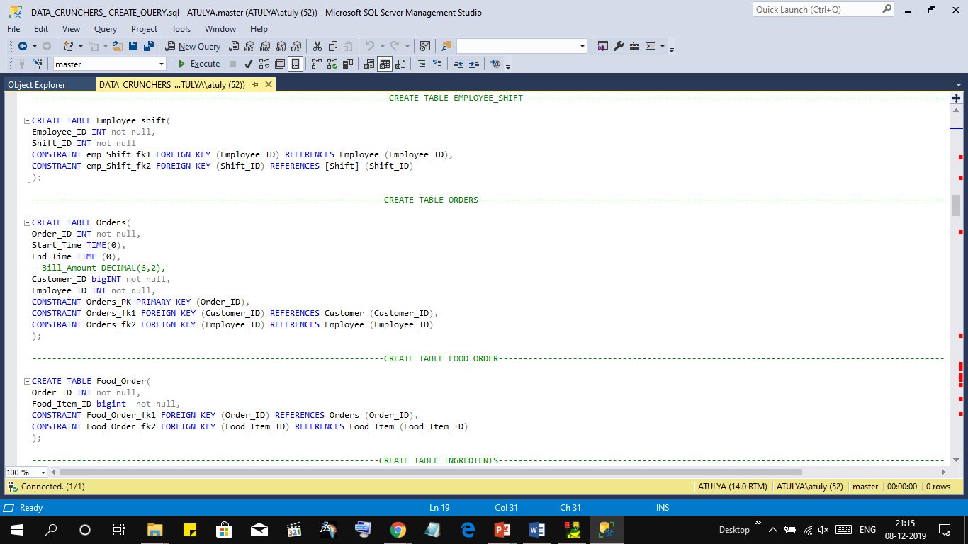
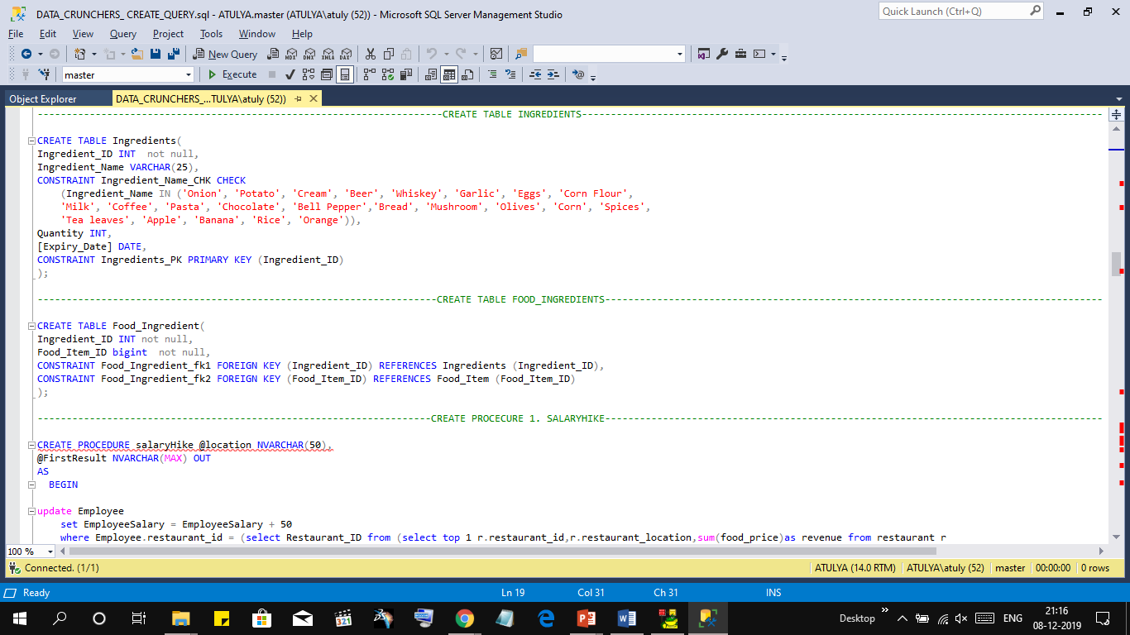
DDL STATEMENTS

Slide 9
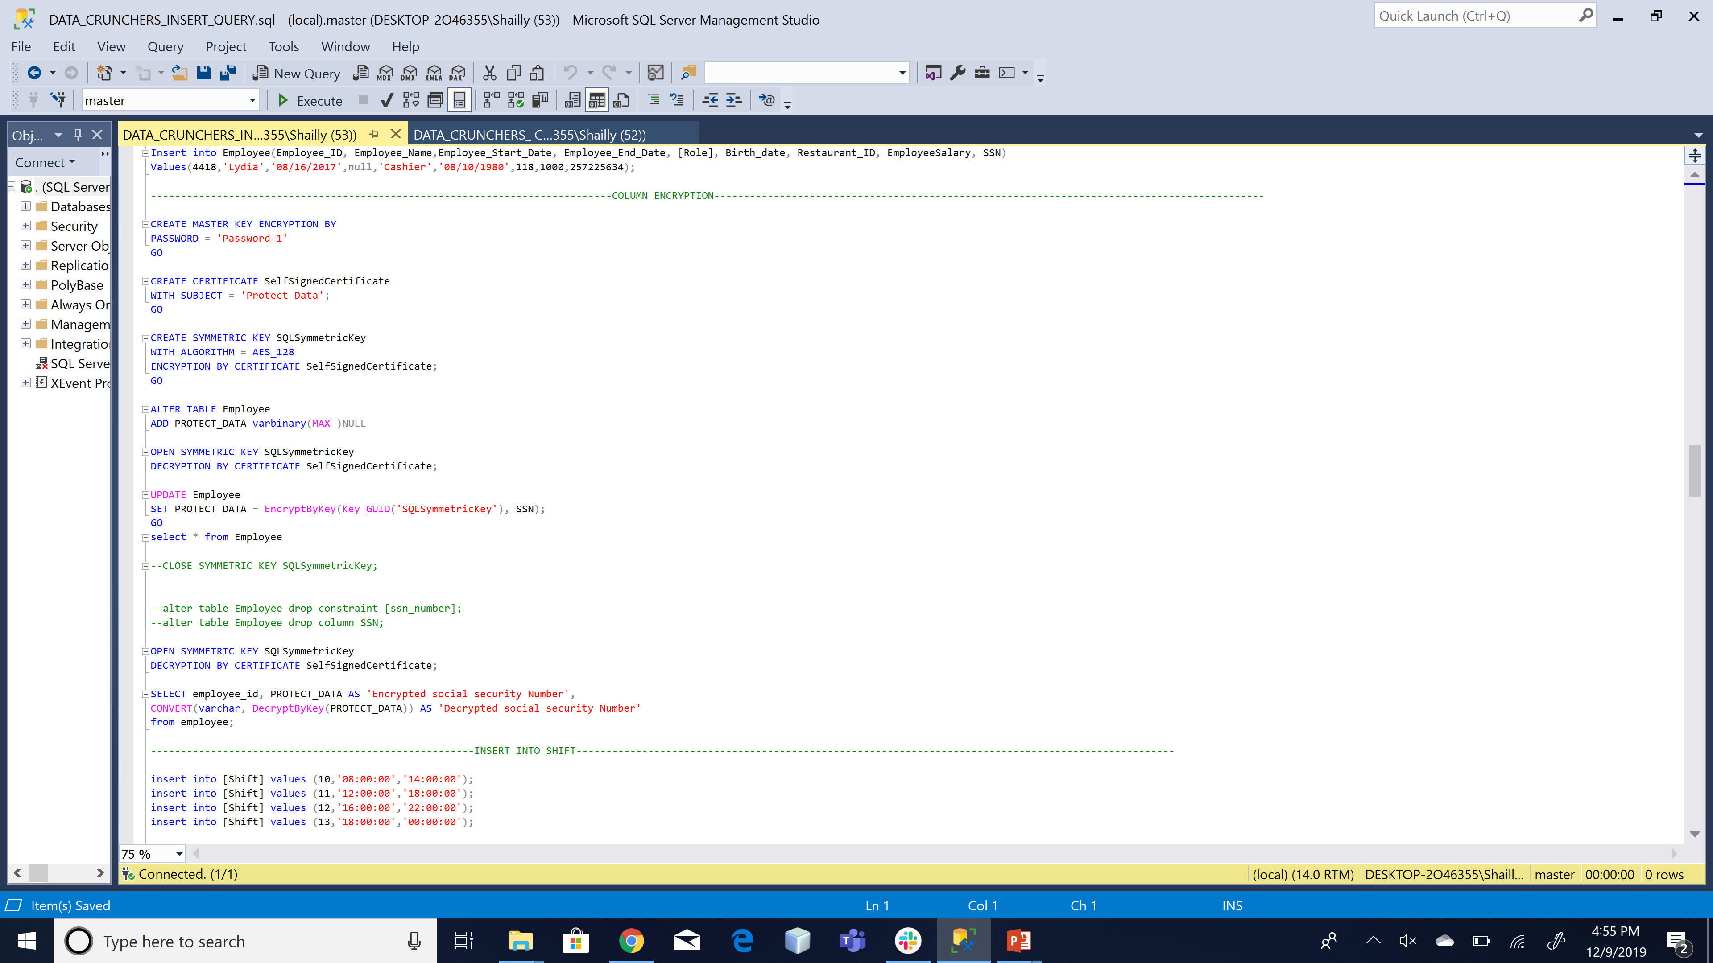
COLUMN ENCRYPTION

Slide 10
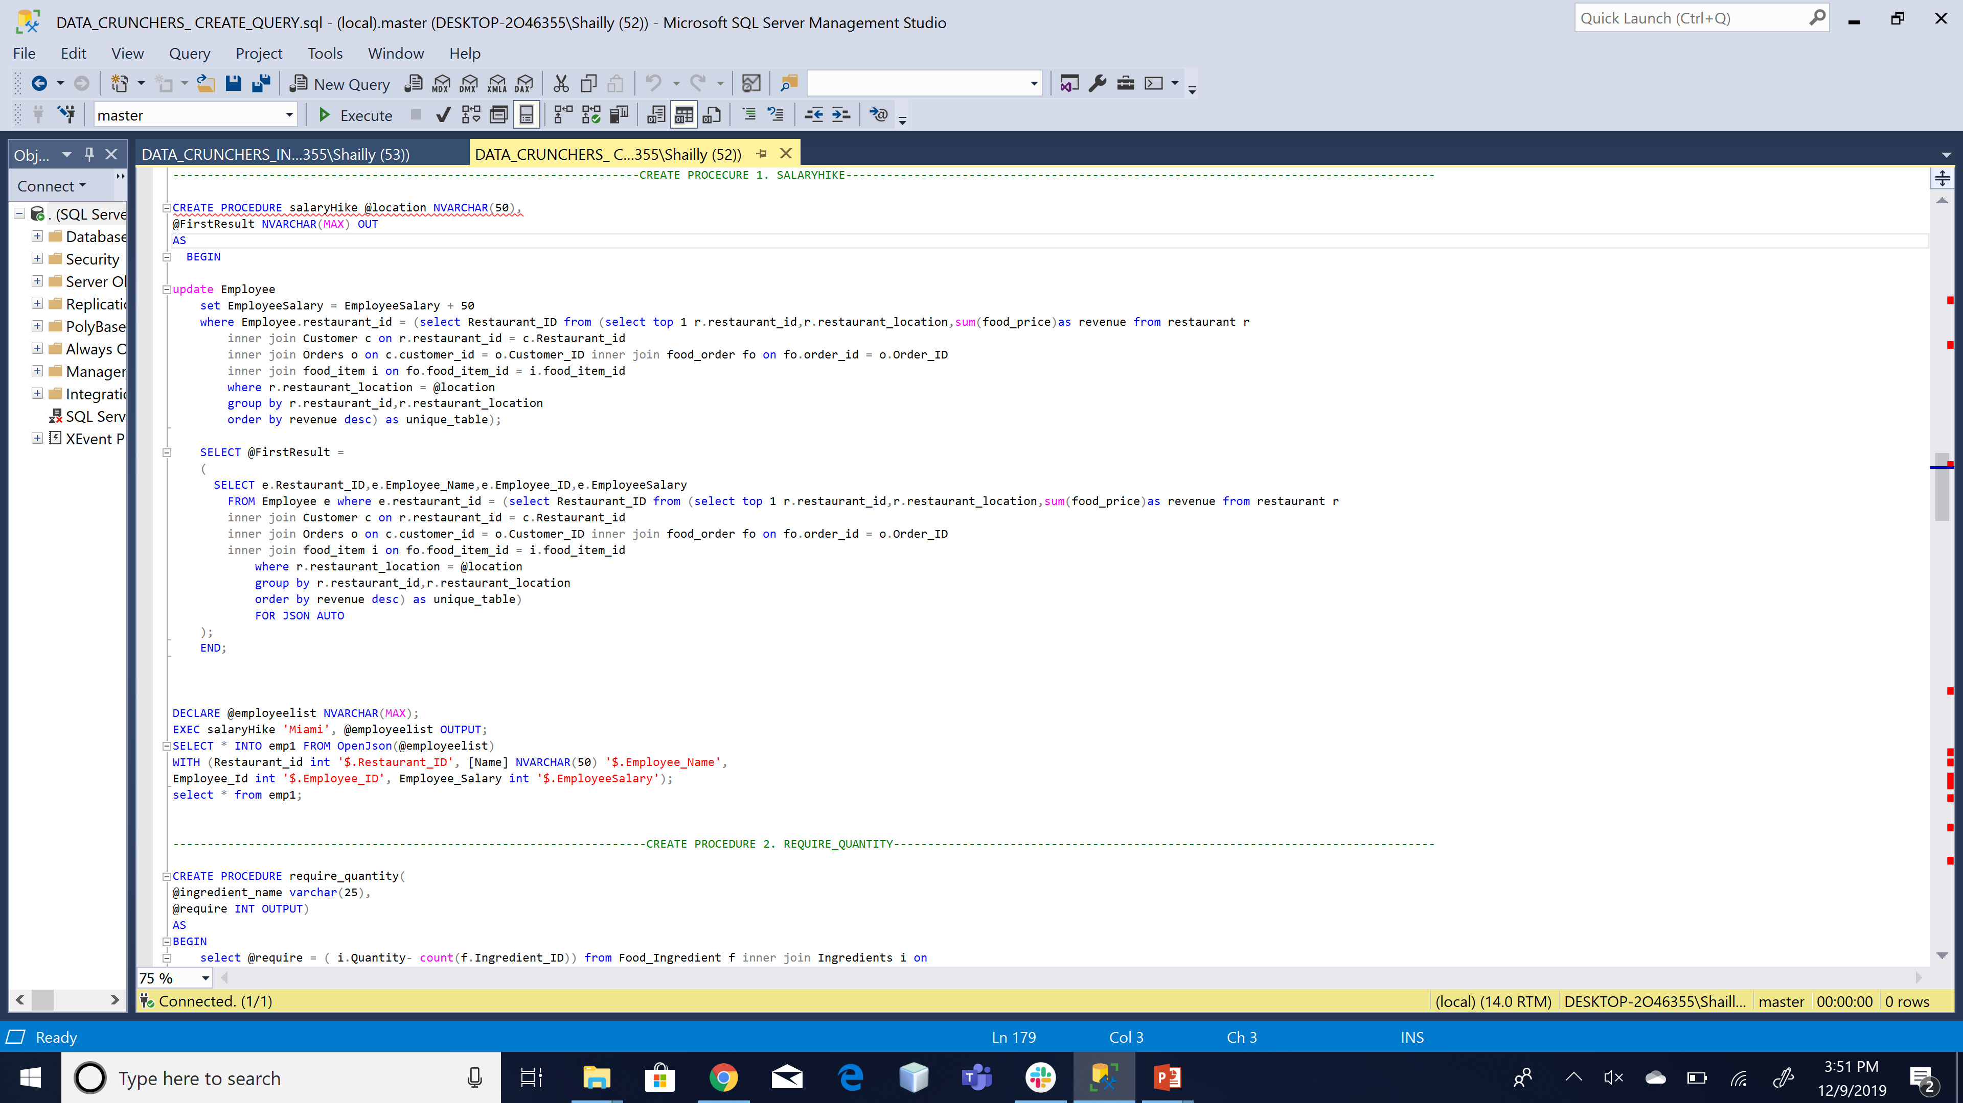
STORED PROCEDURE

Slide 11
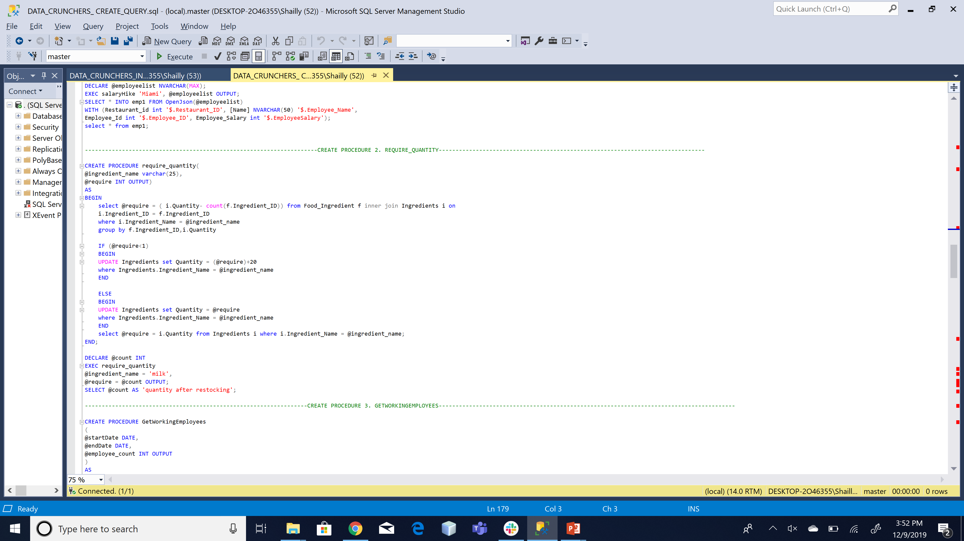
STORED PROCEDURE

Slide 12
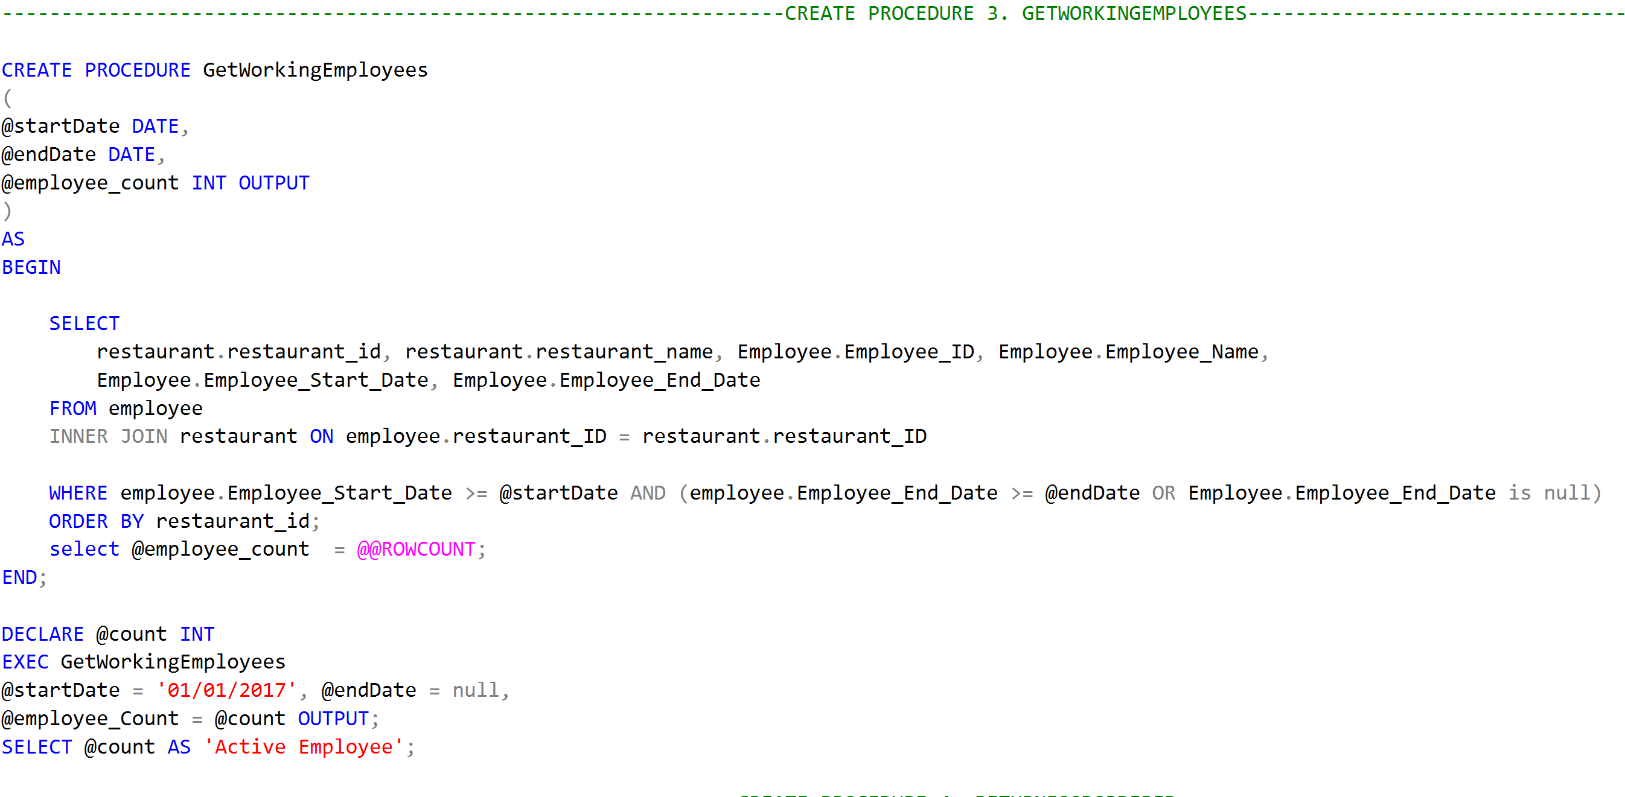
STORED PROCEDURE

Slide 13
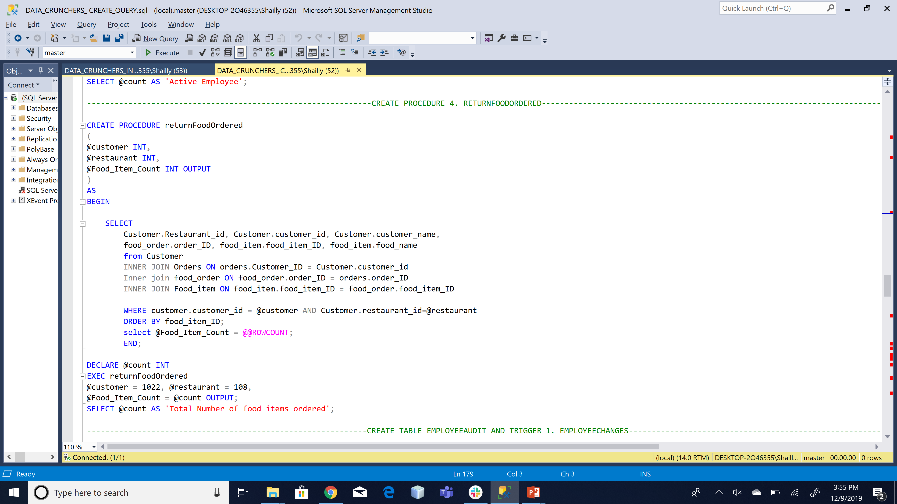
STORED PROCEDURE

Slide 14
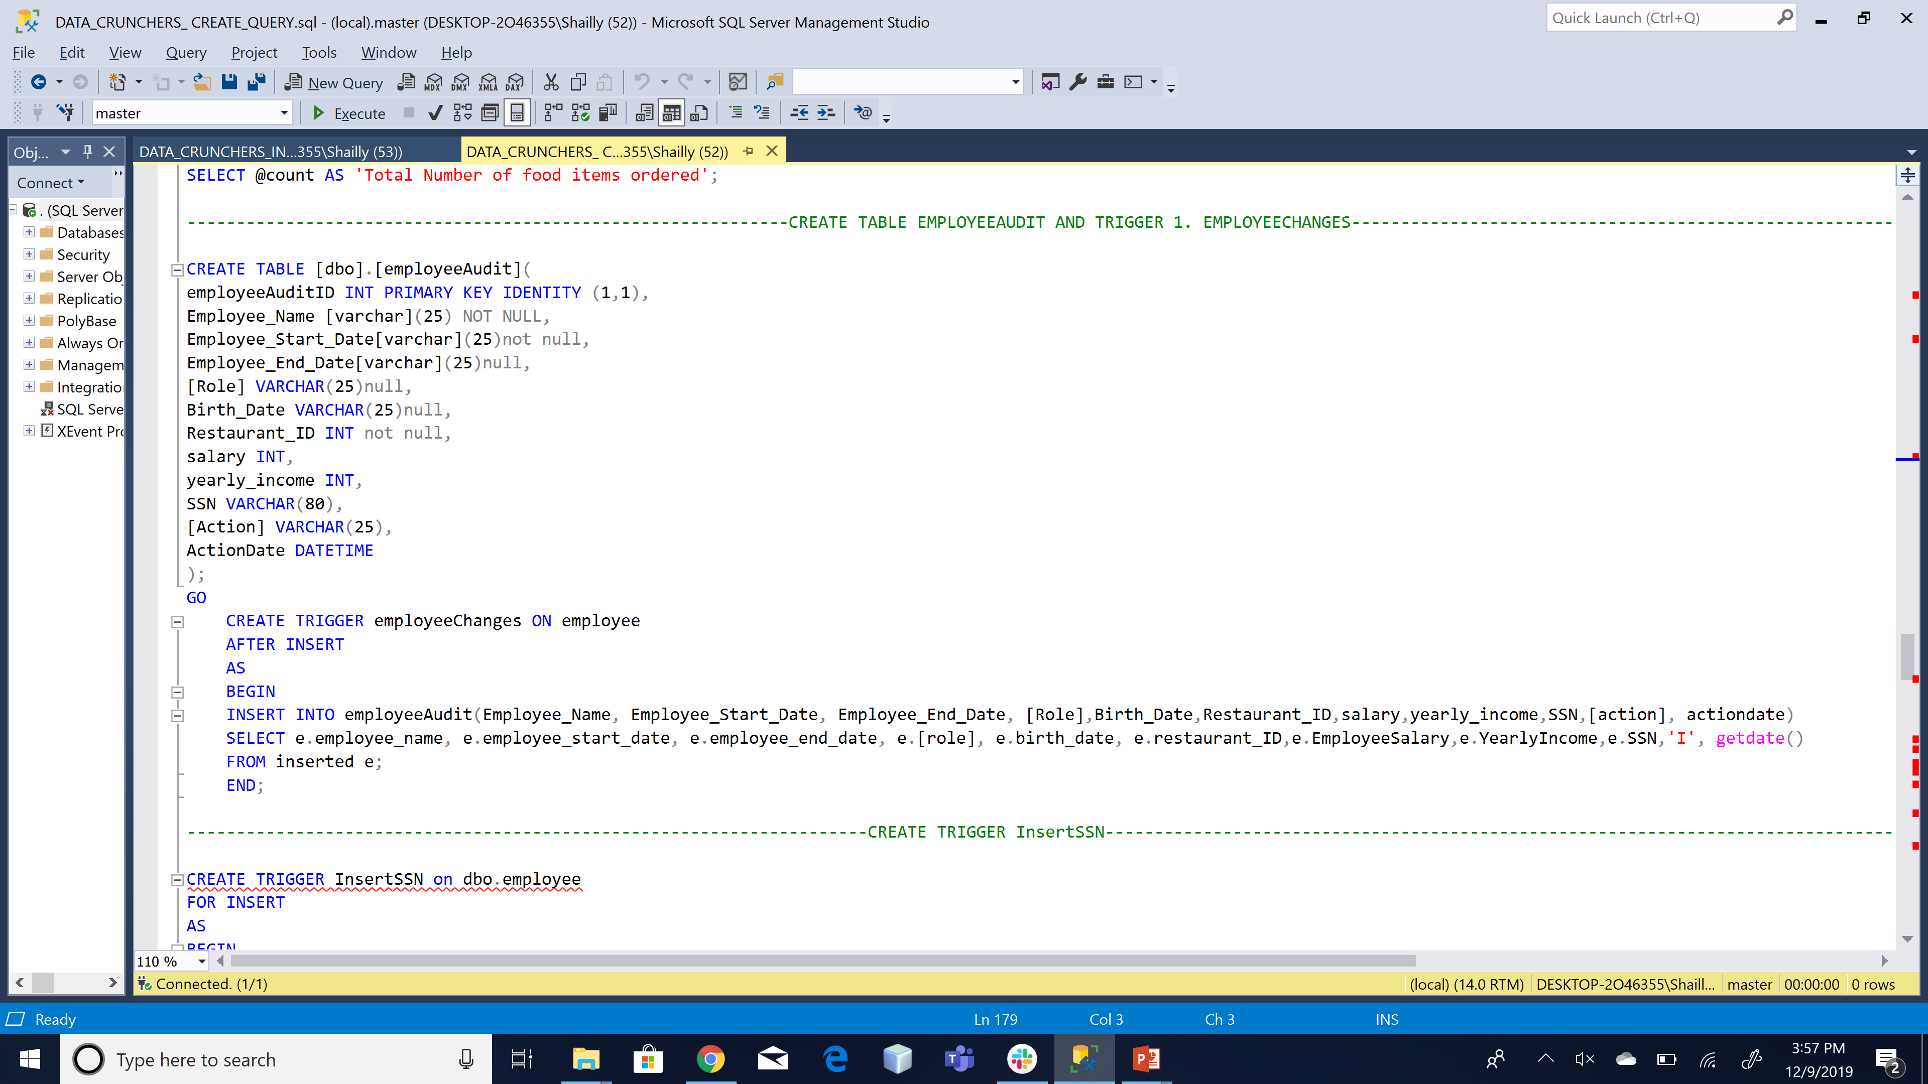
TRIGGERS

Slide 15
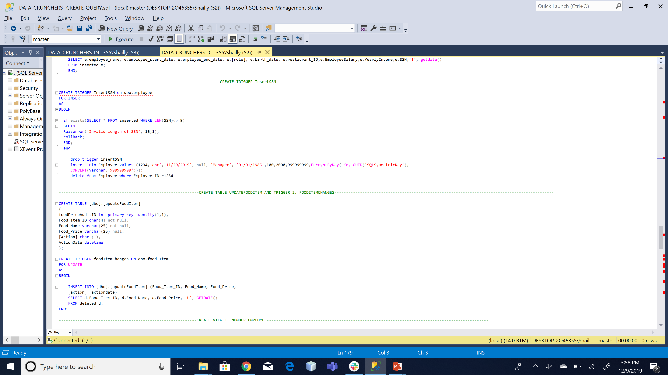
TRIGGERS

Slide 16
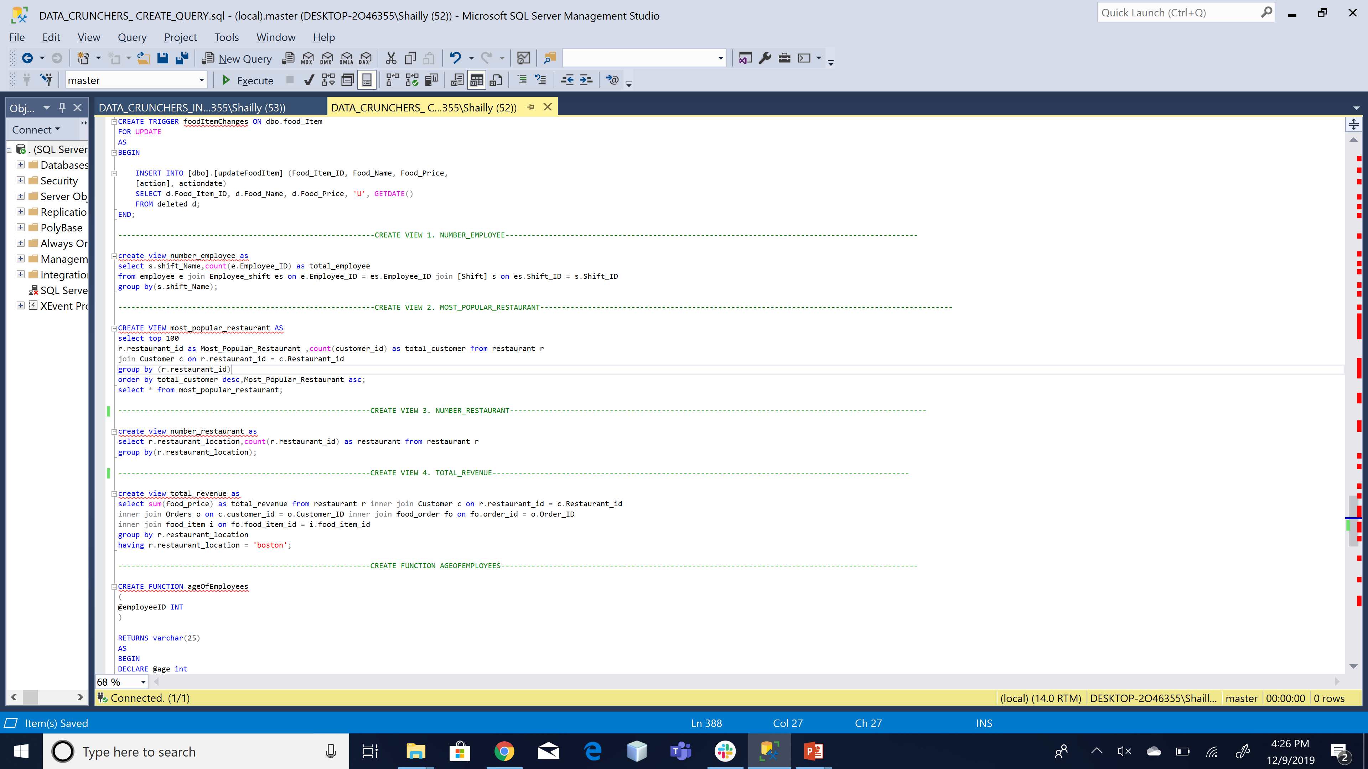
VIEWS

Slide 17
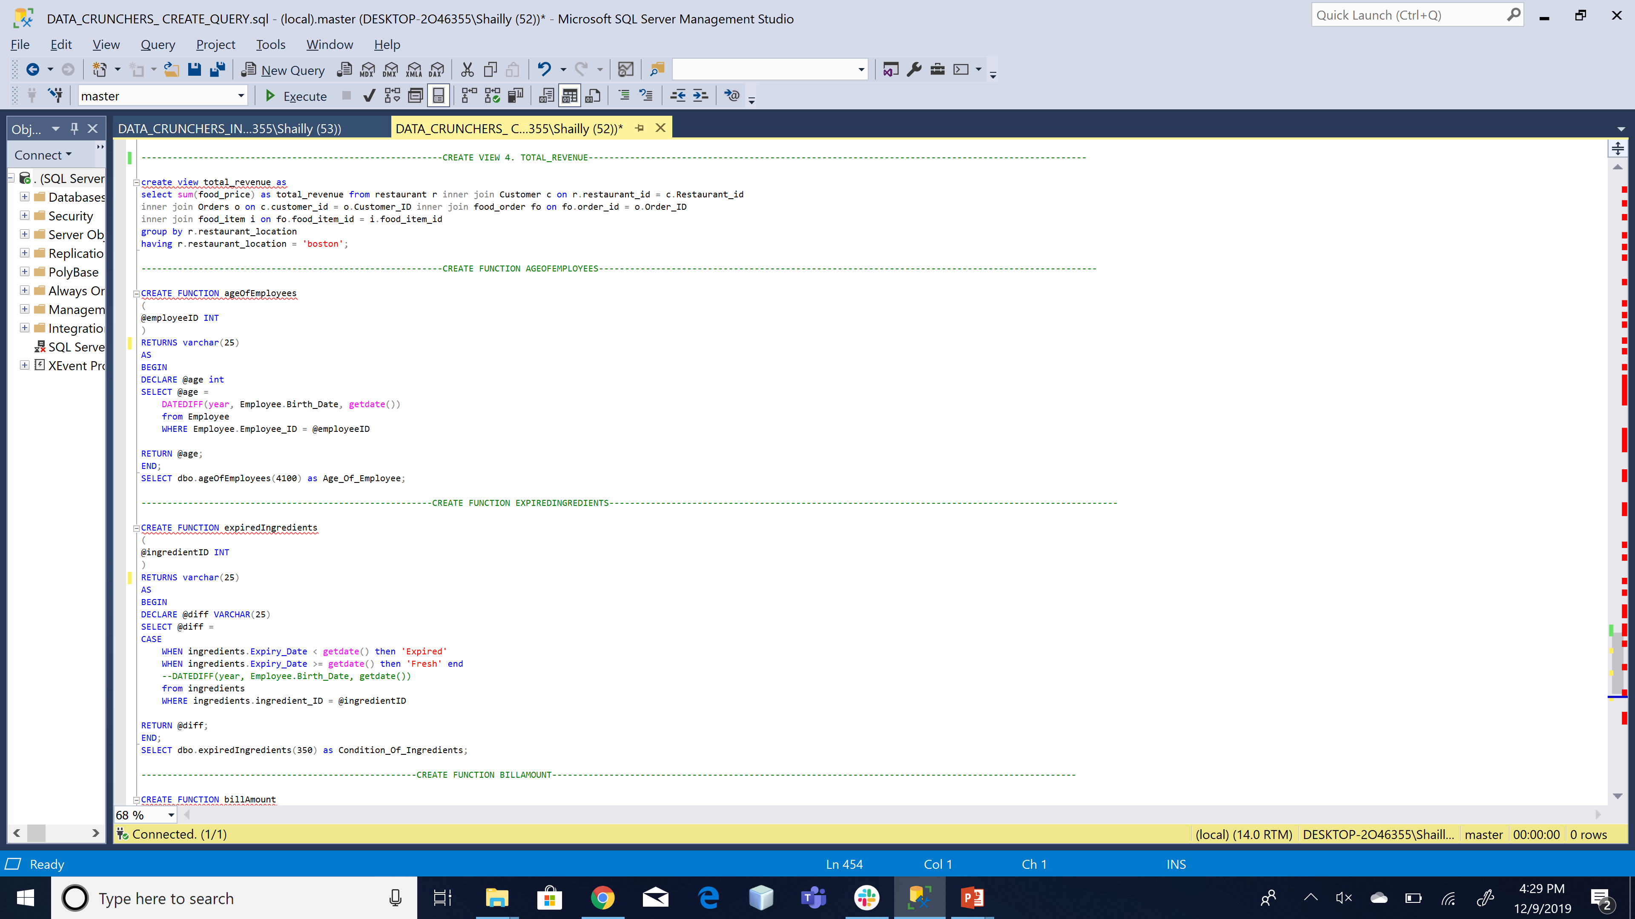
FUNCTIONS

Slide 18
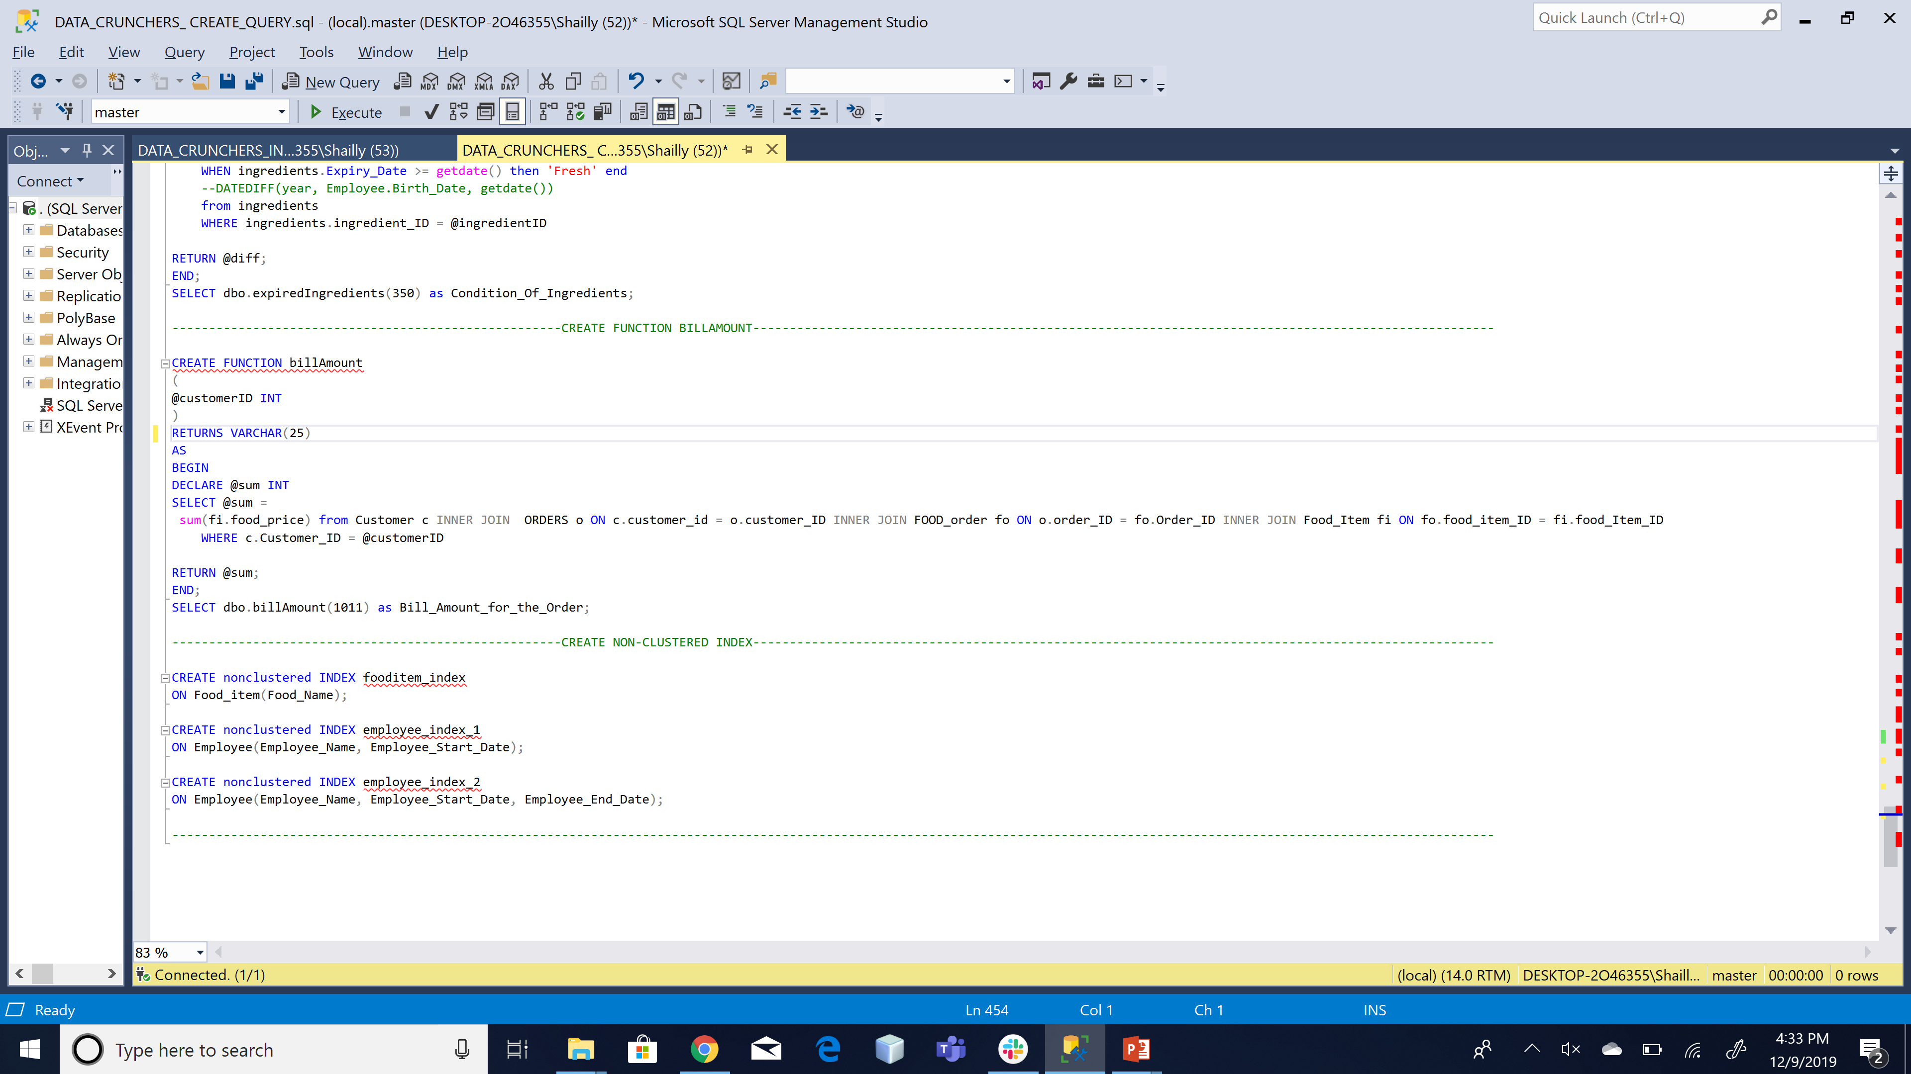
FUNCTIONS

Slide 19
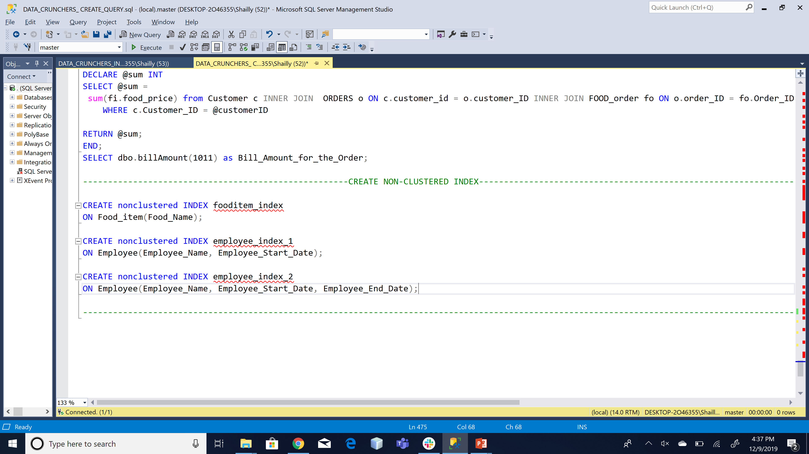
INDEX

Slide 20
POWER BI

Slide 21
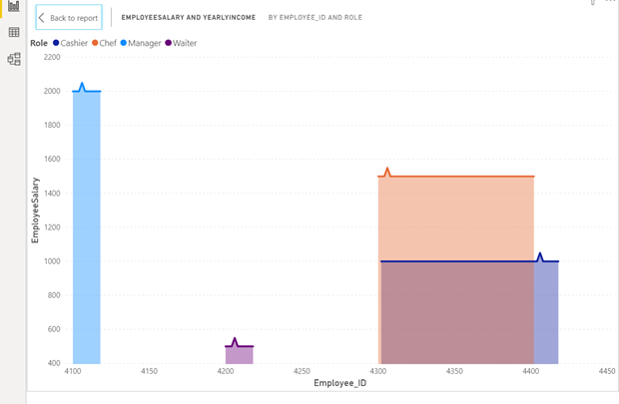
BEST CASHIER

Slide 22
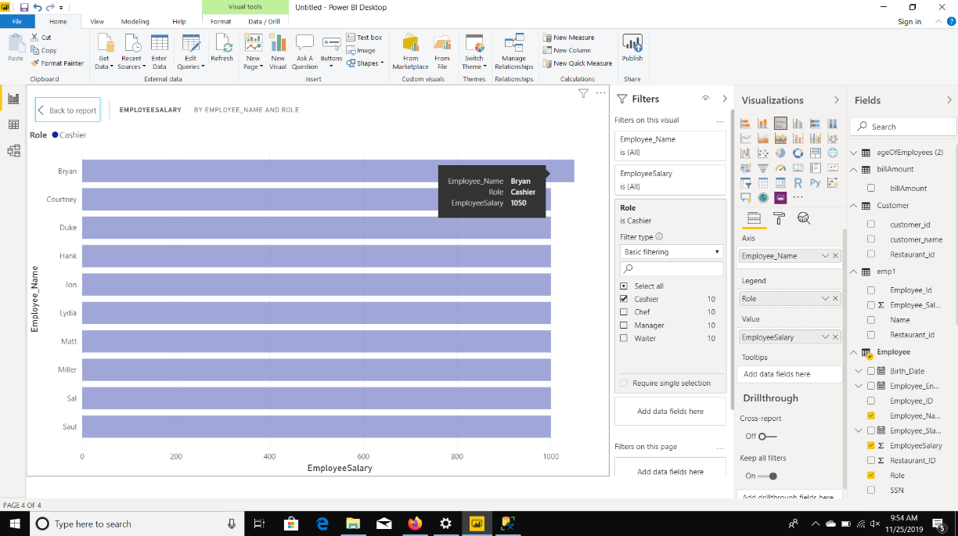
BEST CASHIER

Slide 23
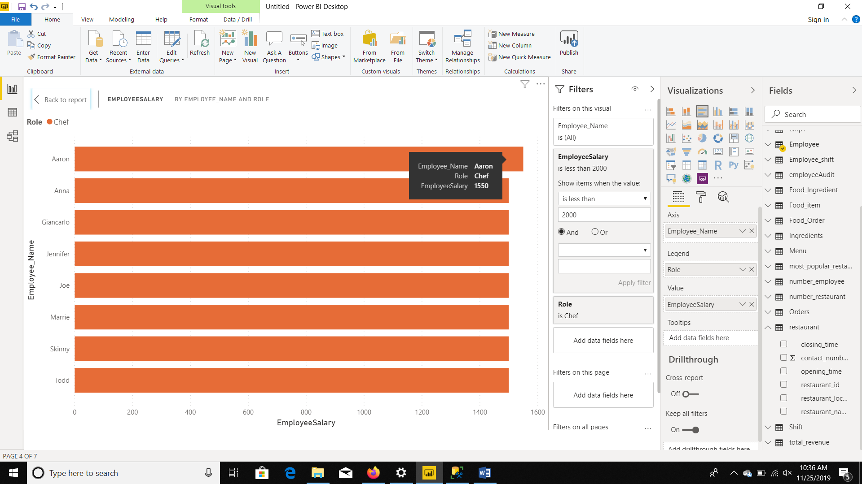
BEST CHEF

Slide 24
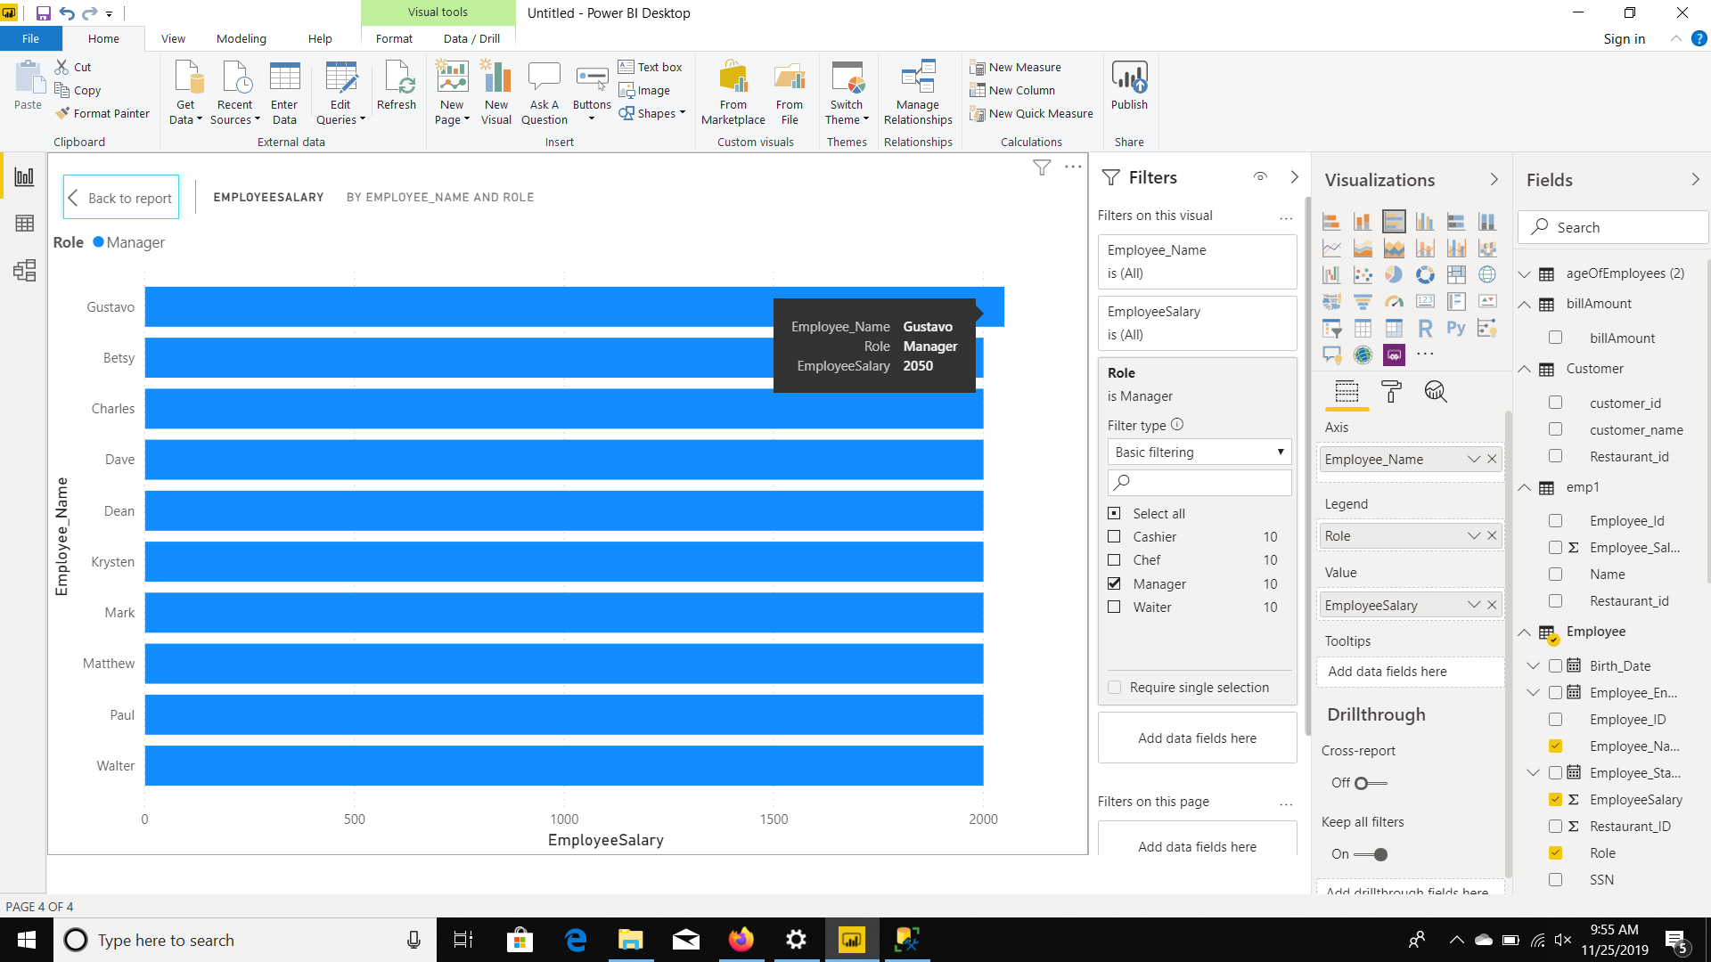
BEST MANAGER

Slide 25
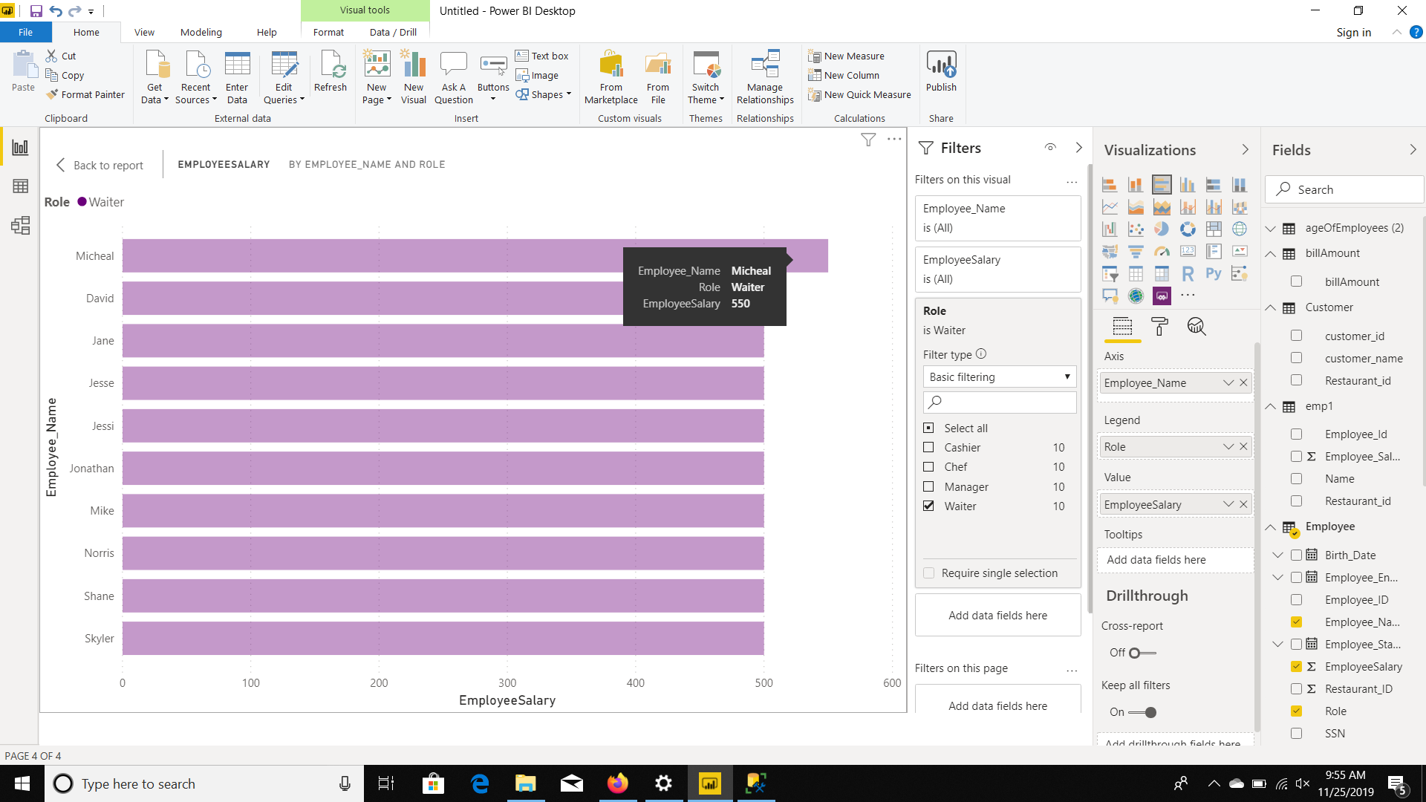
BEST WAITER

Slide 26
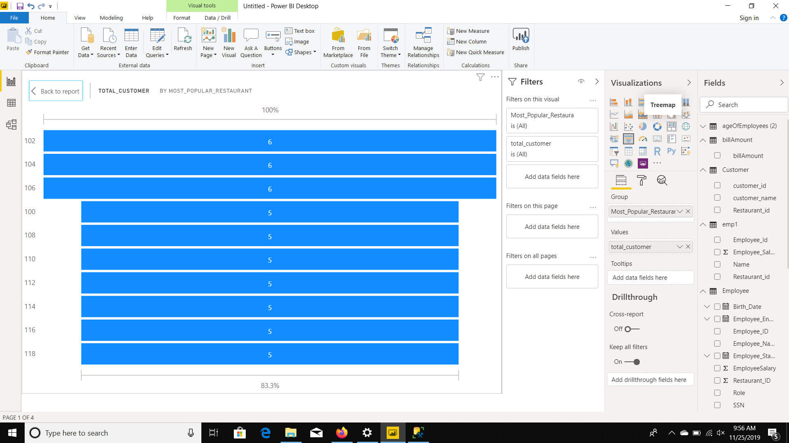
BEST RESTAURANT BY TOTAL CUSTOMERS

Slide 27
RESTAURANTS BASED ON LOCATION

Slide 28
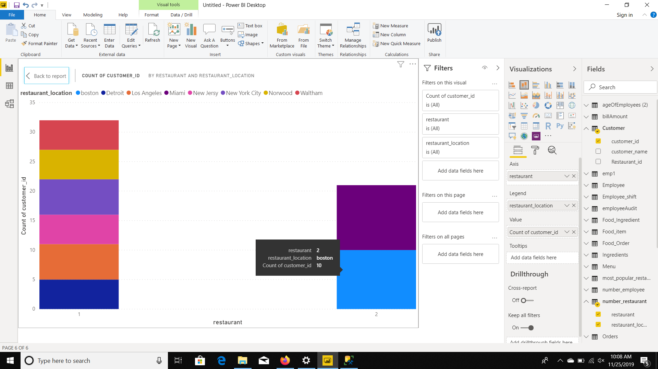
BOSTON

Slide 29
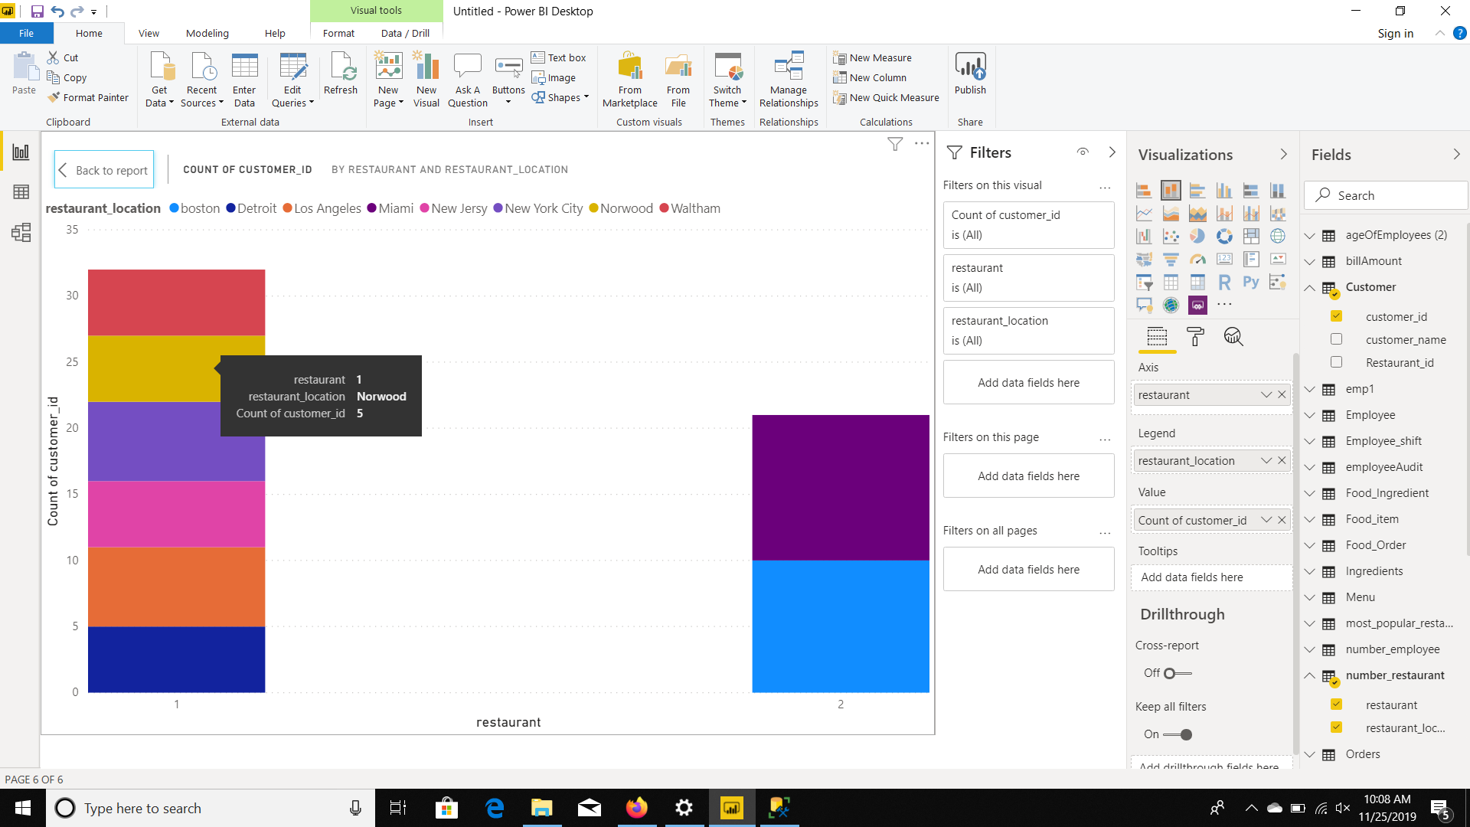
NORWOOD

Slide 30
FUNCTIONS

Slide 31
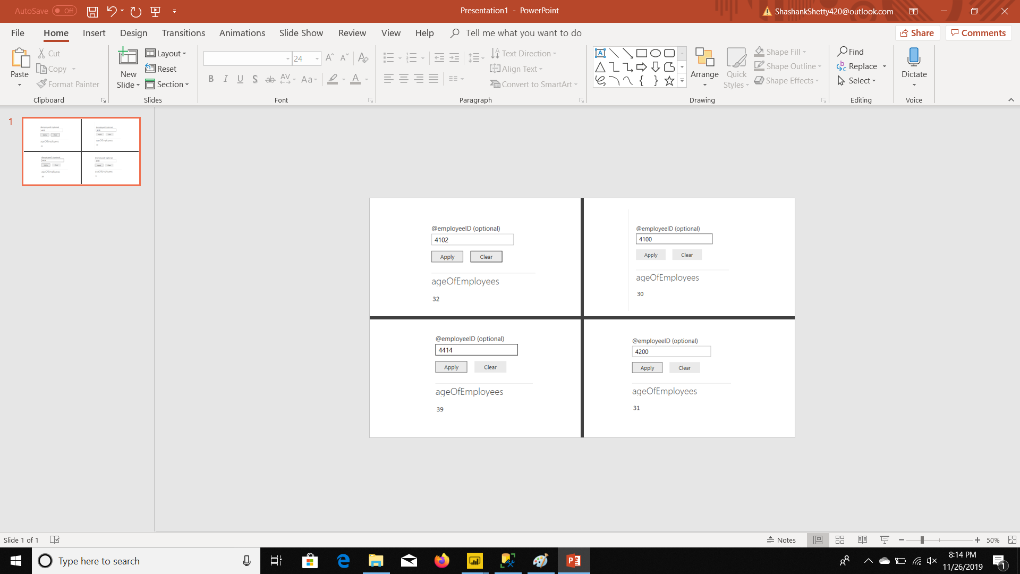
AGE OF EMPLOYEES

Slide 32
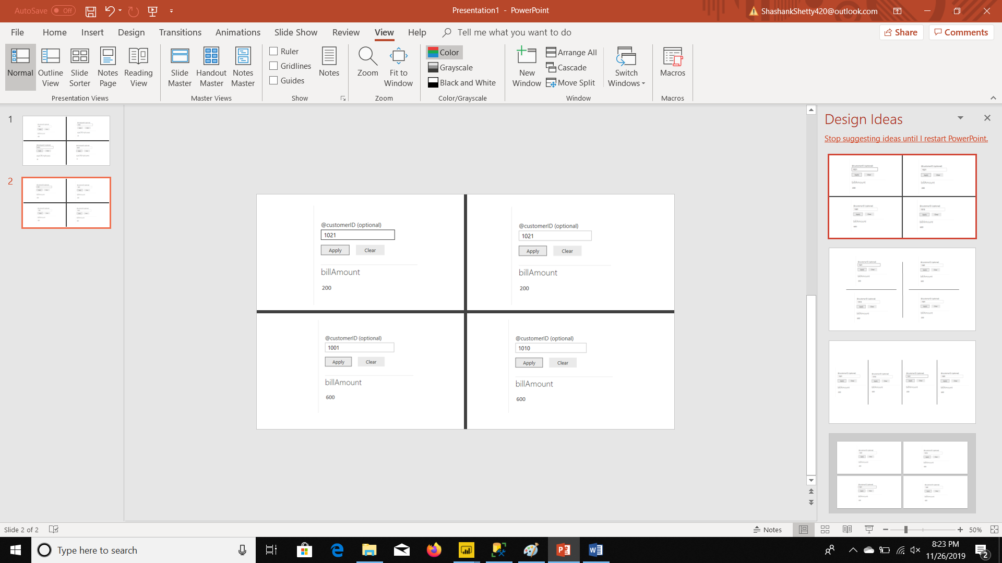
TOTAL BILL

Slide 33
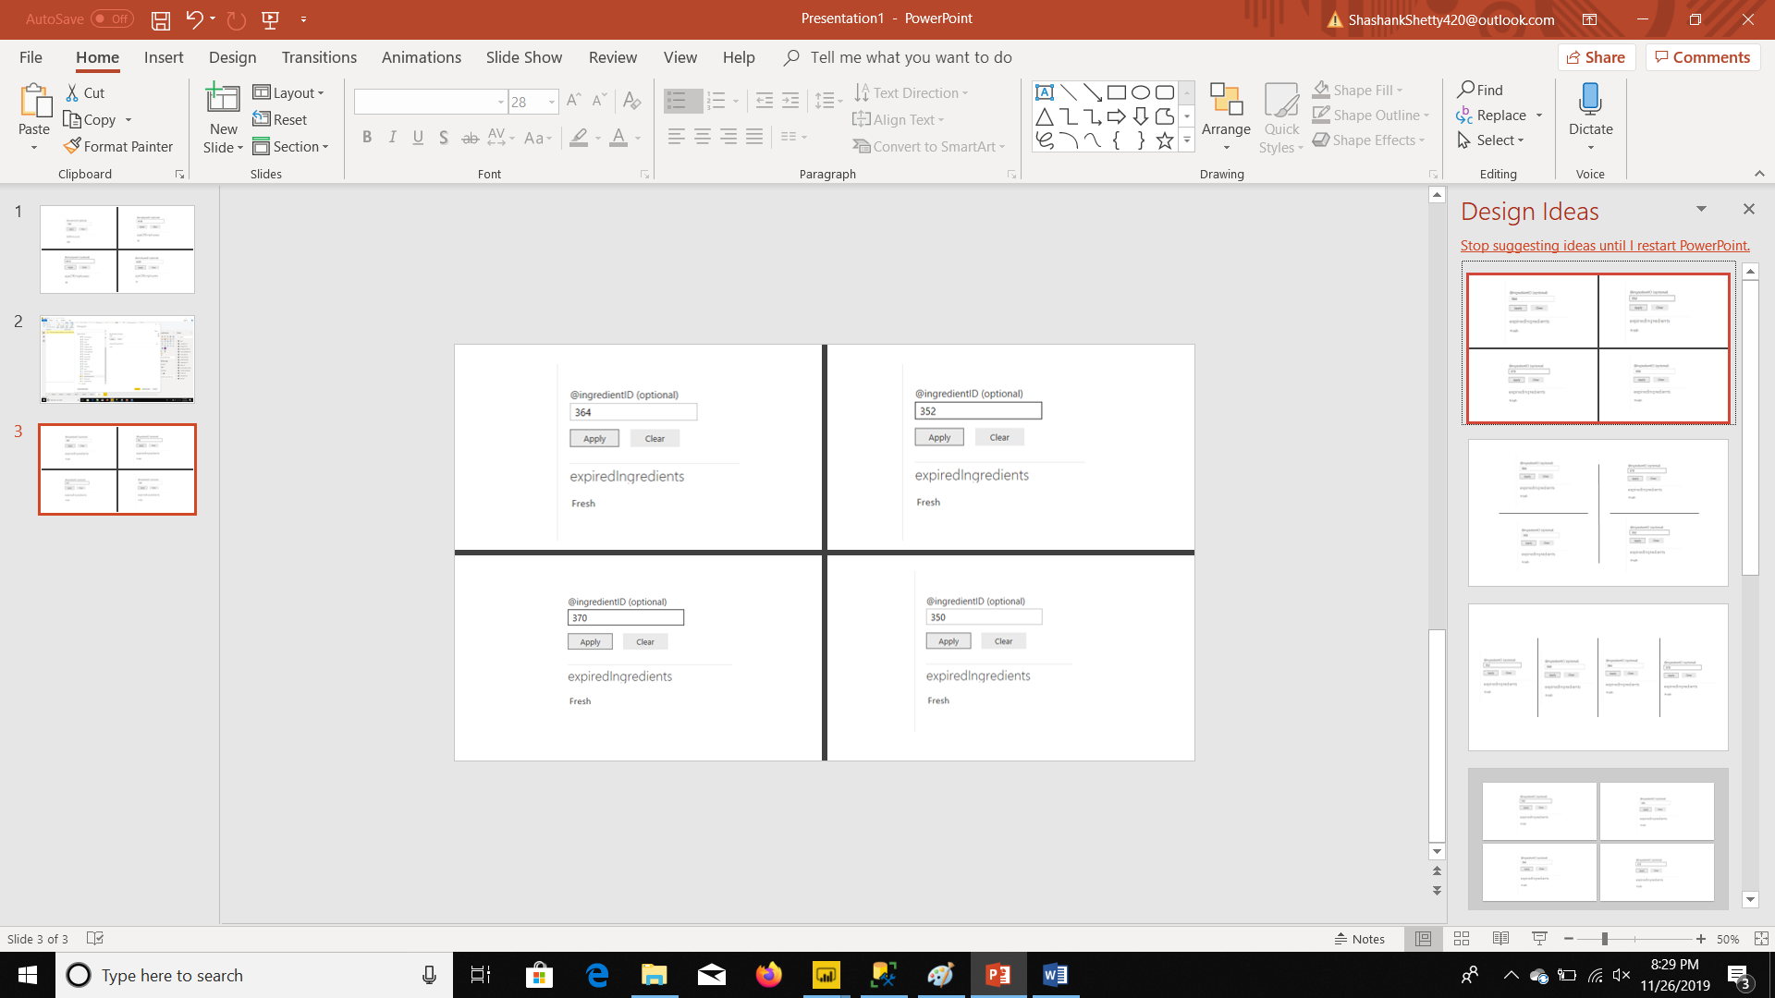
EXPIRED/FRESH

Slide 34
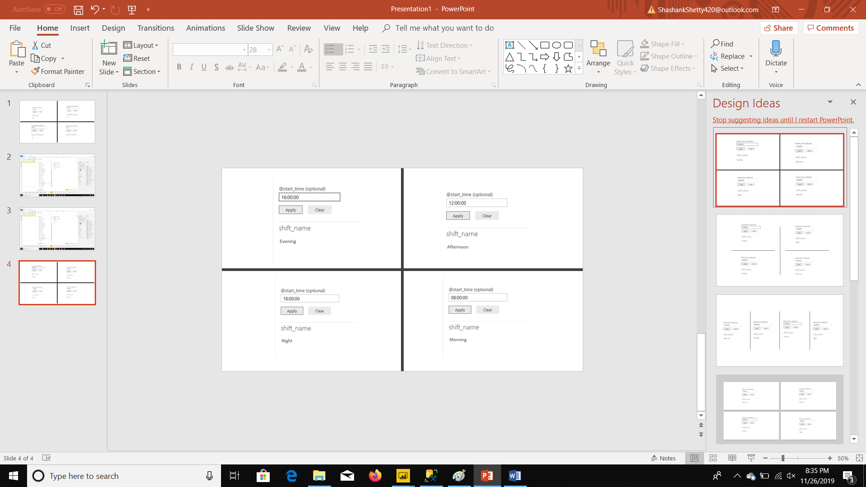
SHIFT NAMES

Slide 35
THANK YOU !!

